Slide 1
Neural Network Analysis for Lung Cancer Prediction
Overview of Architecture, Training, Activation Functions, Loss Functions, Accuracy, and ROC Curve
Kamaal Bartlett

Slide 2
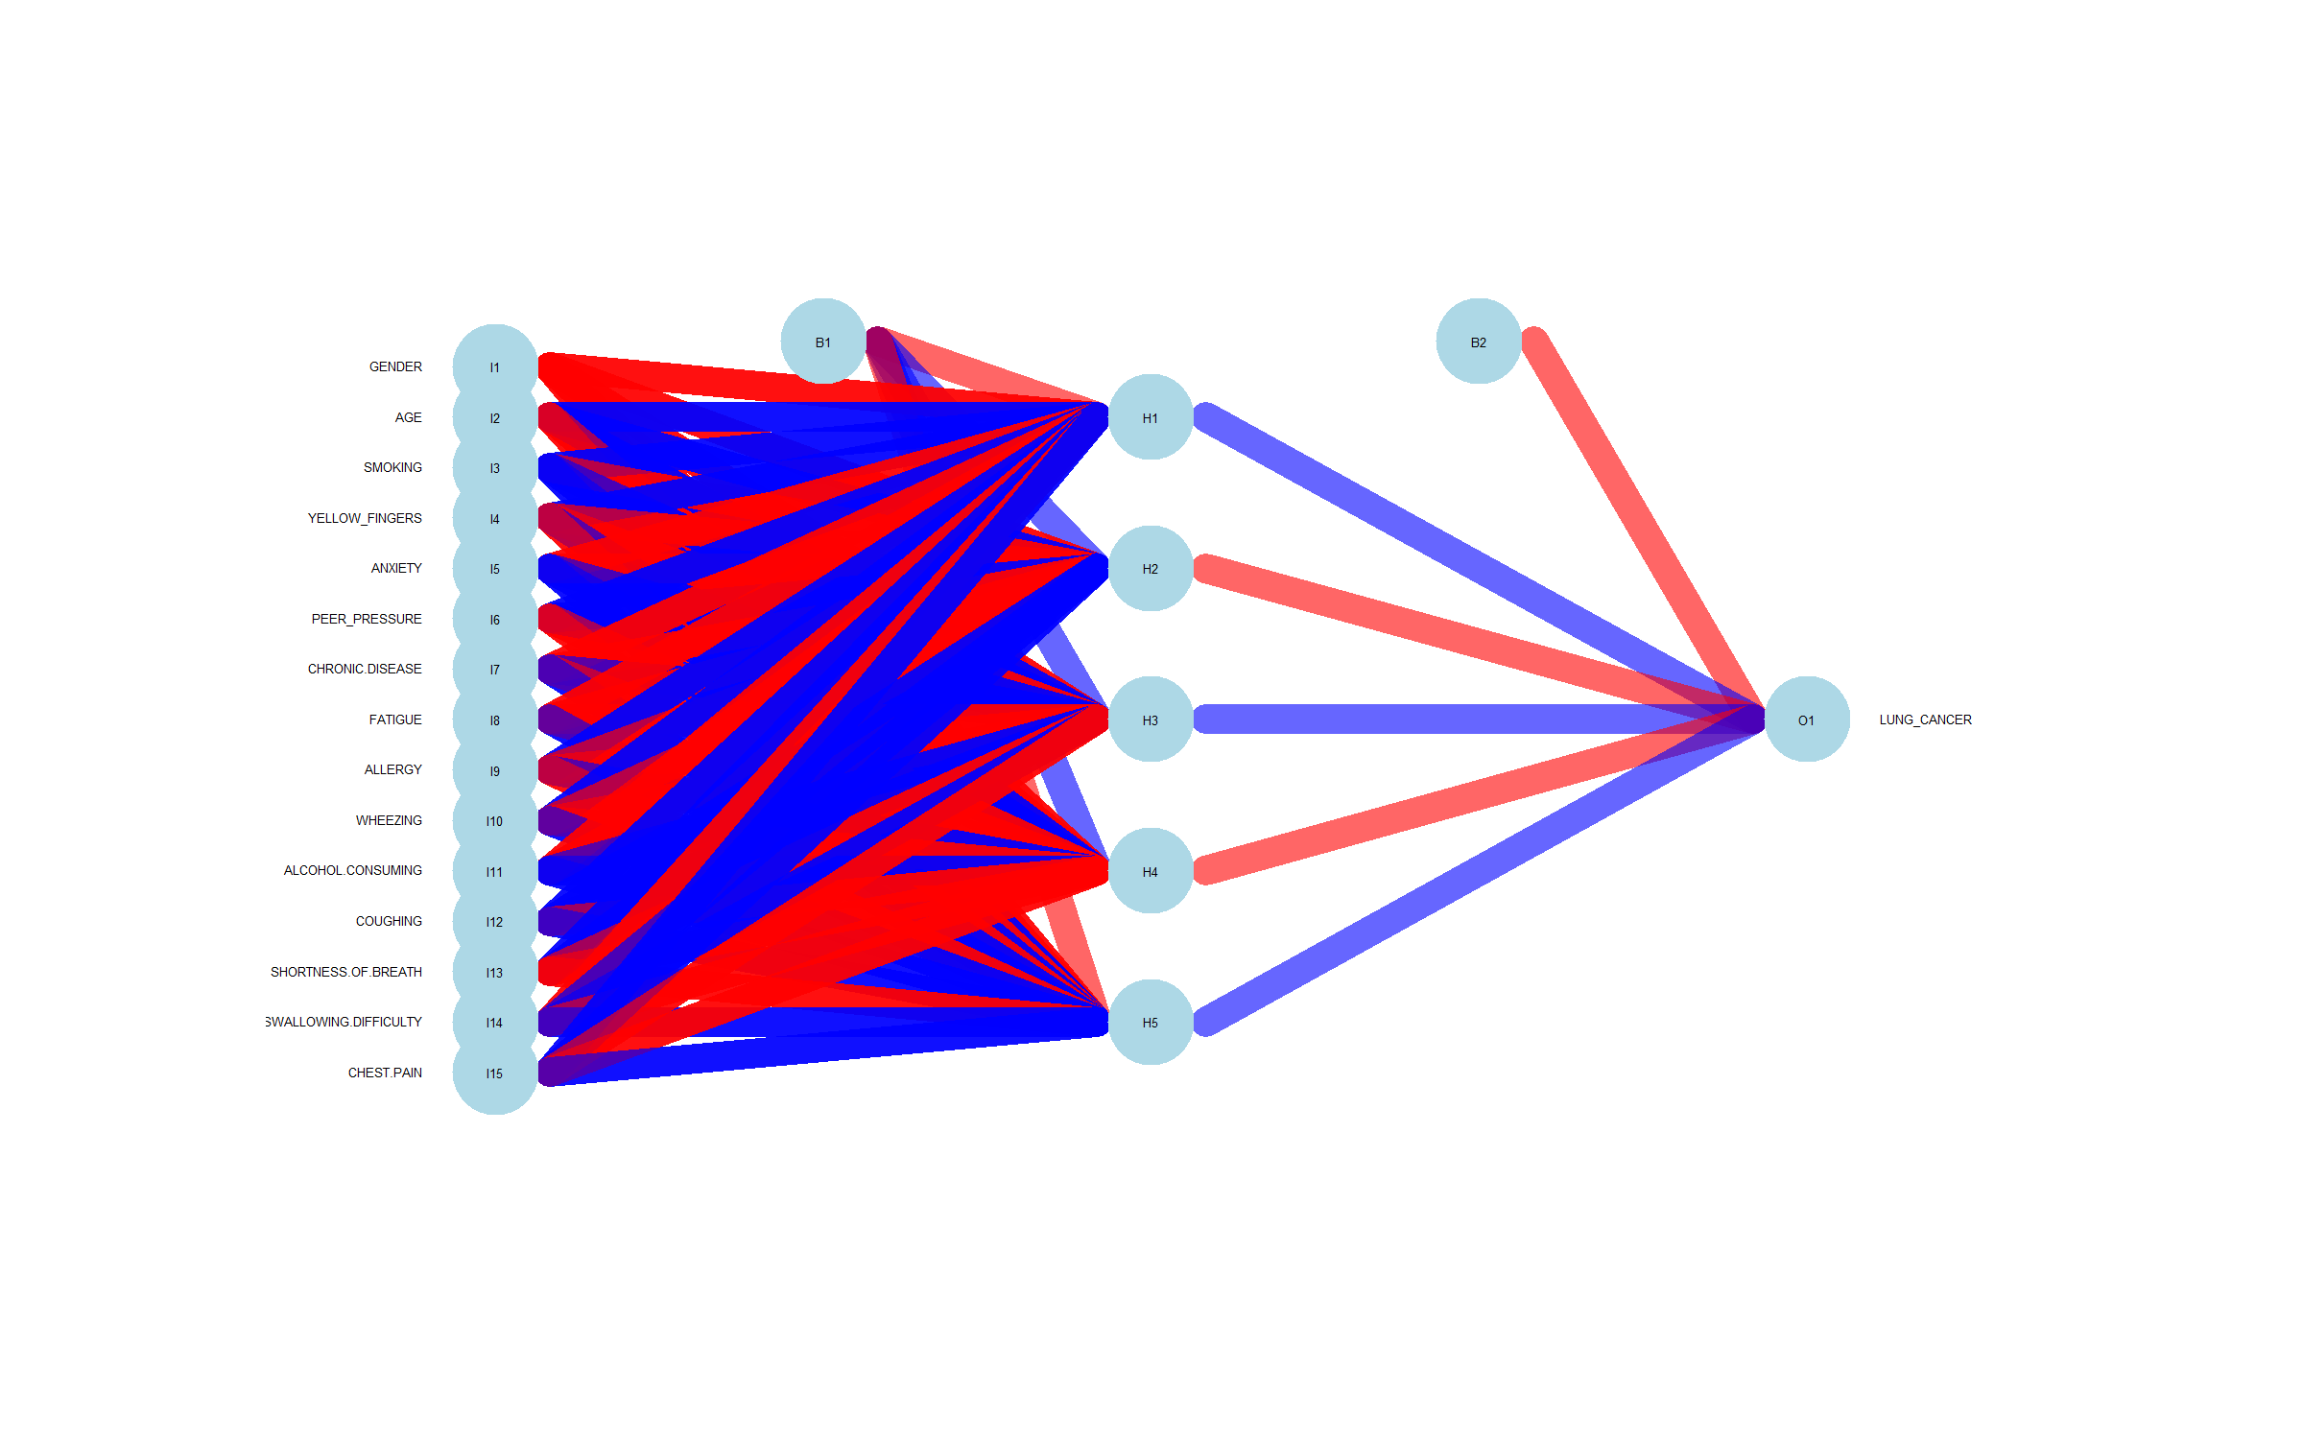
Introduction to Feedforward Neural Networks
What is a feed-forward neural network (FNN)
Input, hidden, and output layers.
Weights and biases transform the input through each layer.

Slide 3
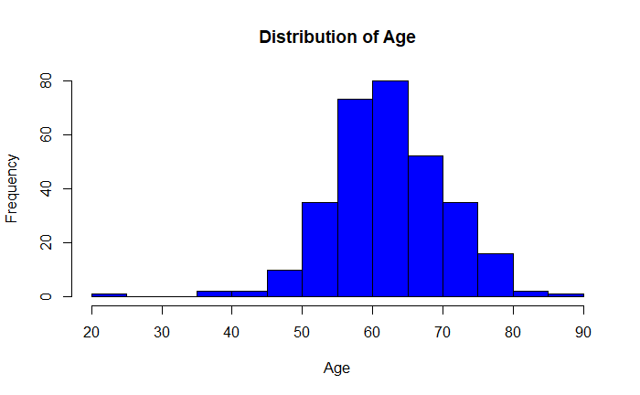
Data Preview

Slide 4
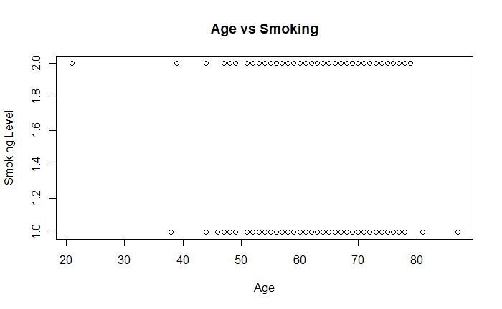
Data Preview

Slide 5
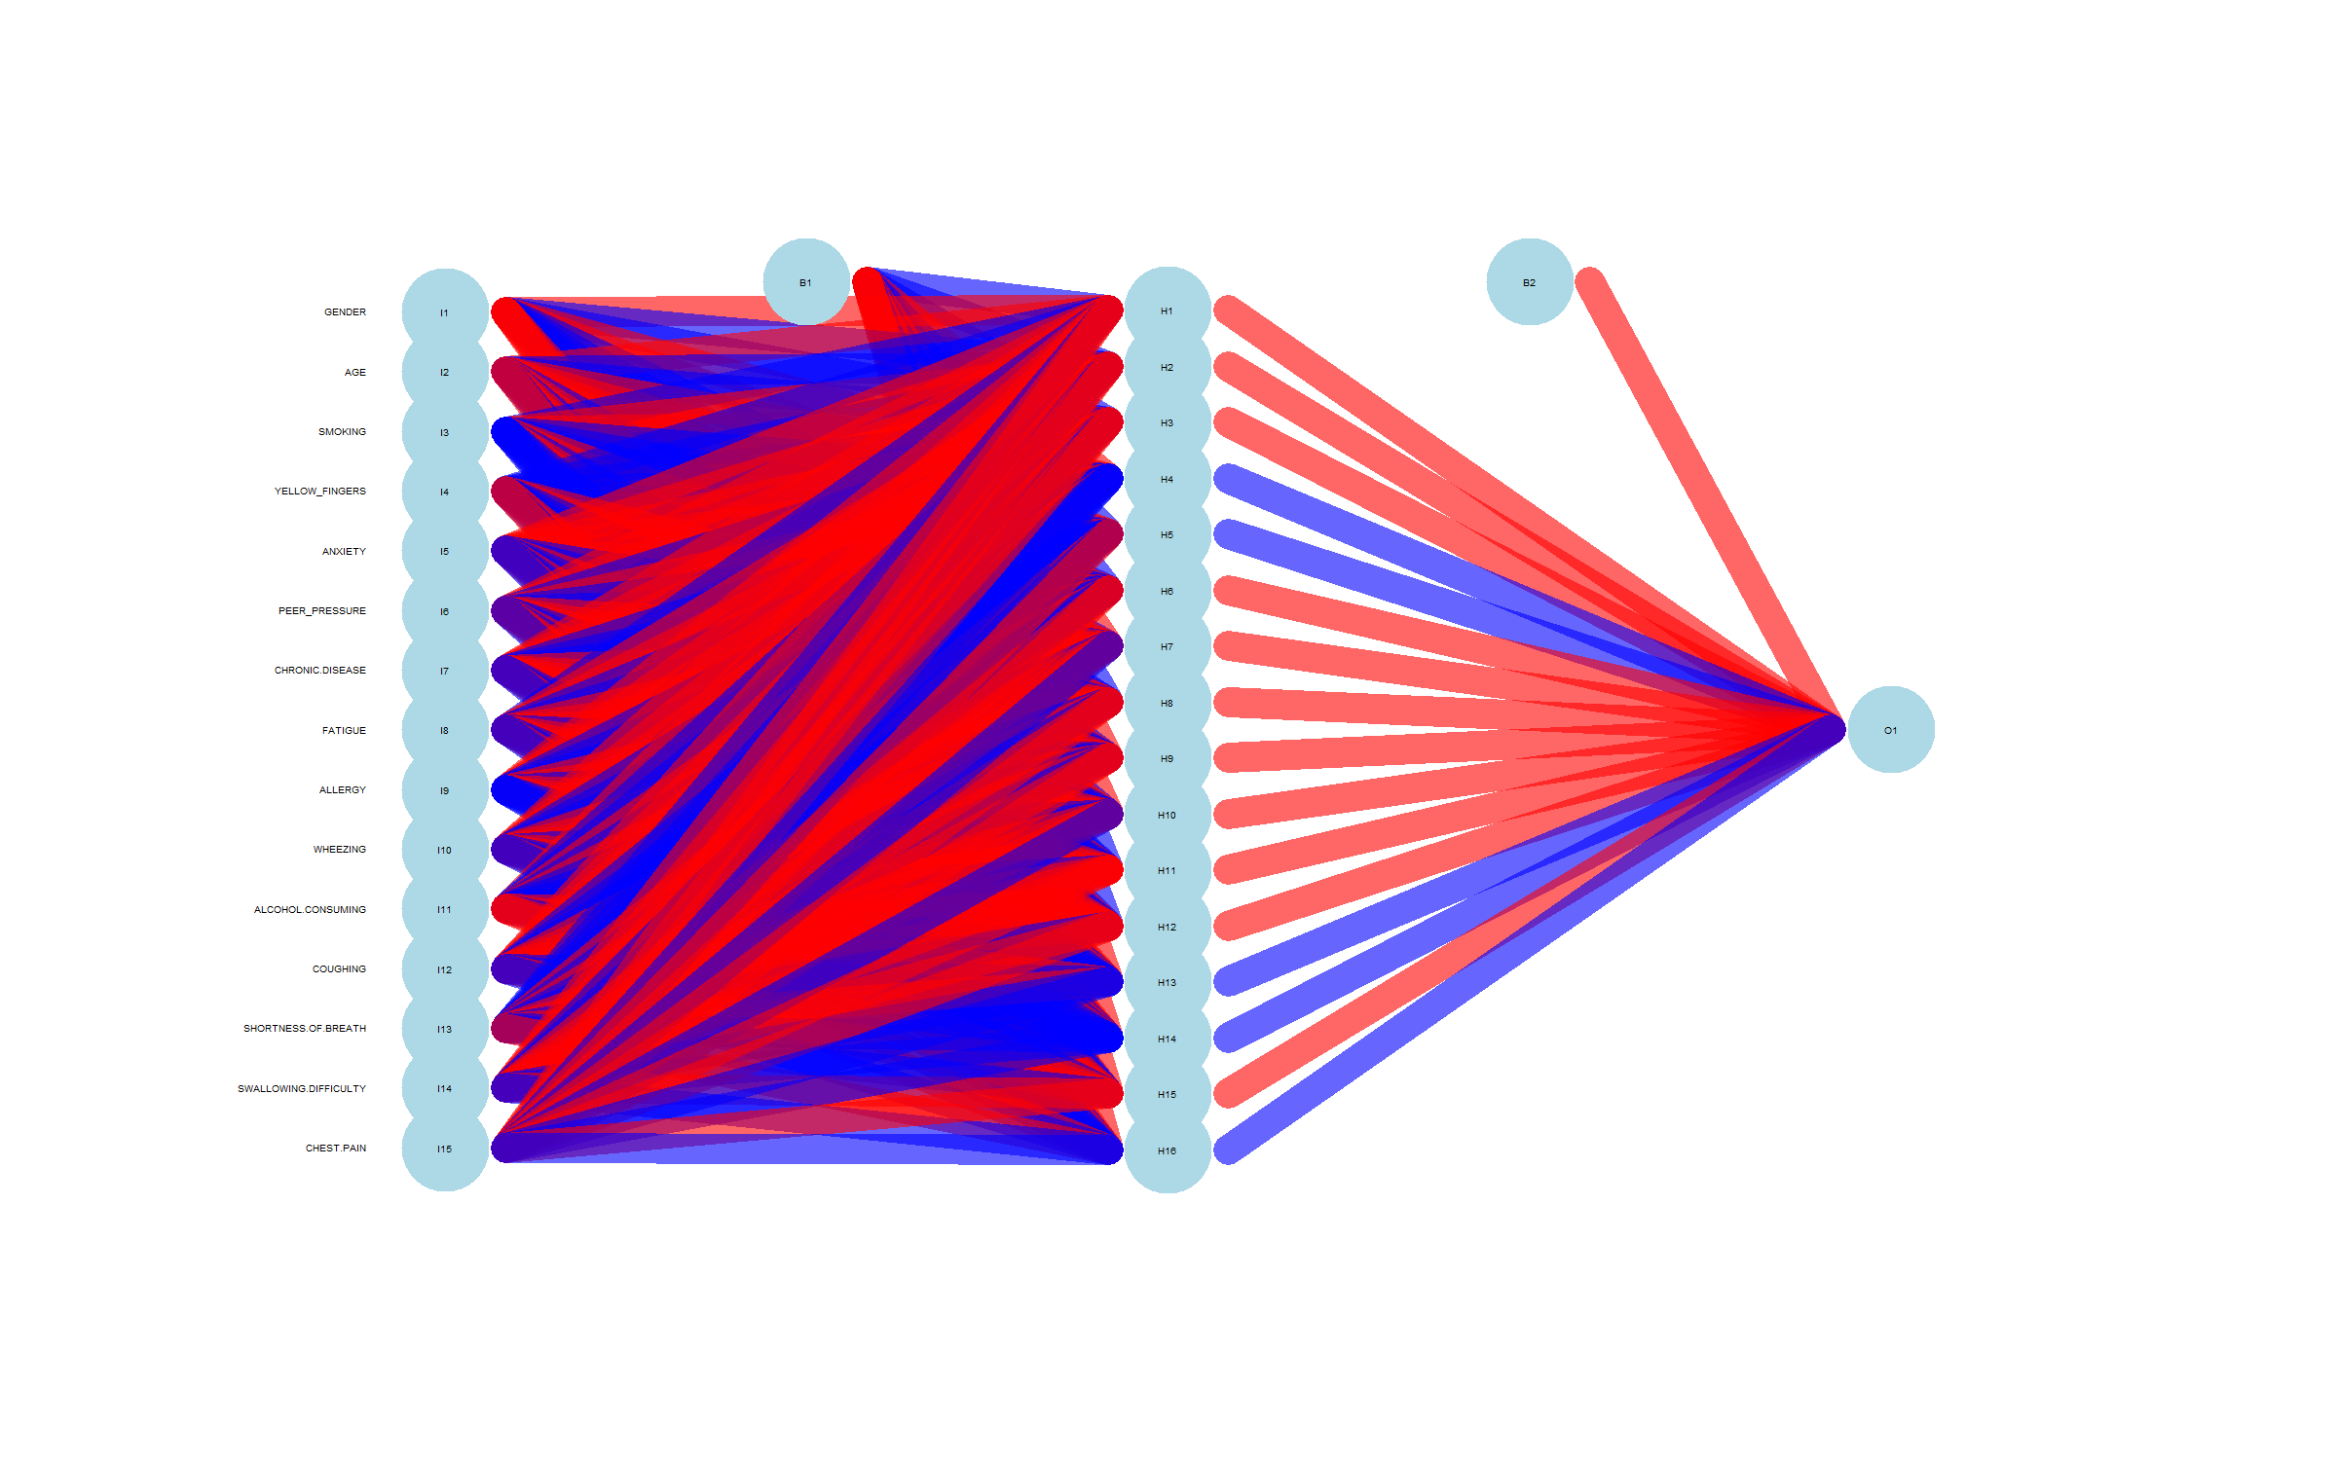
Training Sets and Epochs
Training sets are subsets of the data used to train the model.
An epoch is one complete iteration over the entire training dataset.
Multiple epochs help the model learn by adjusting weights and biases.

Slide 6
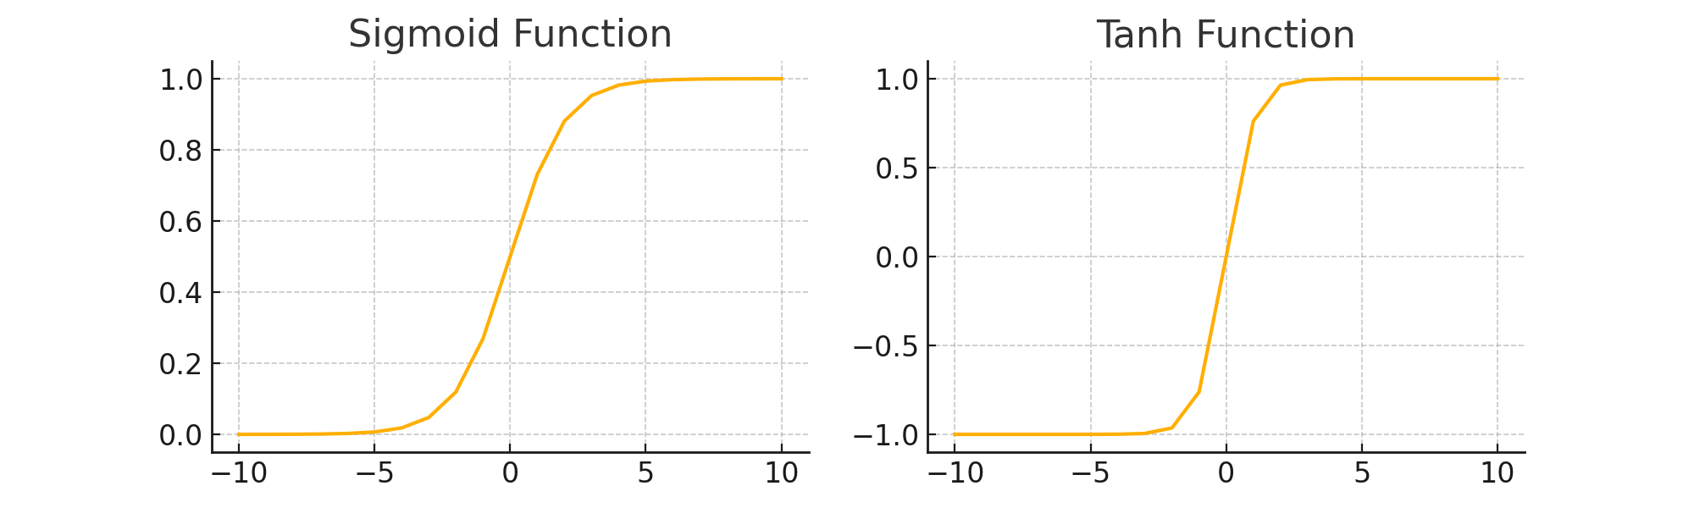
Activation Functions
Activation functions introduce non-linearity into the model.
Sigmoid: Converts input into a range between 0 and 1.
Tanh: Maps input to a range between -1 and 1, centering around zero.

Slide 7
Loss Functions
Loss functions measure the difference between the predicted output and actual output.
Cross-Entropy Loss: Used for classification problems. It measures the difference between actual and predicted probability distributions.
MSE (Mean Squared Error): Penalizes large errors, commonly used for regression tasks.

Slide 8
Model Accuracy and Confusion Matrix
Model accuracy is calculated as the ratio of correct predictions to total predictions.
Confusion Matrix: Shows True Positives, True Negatives, False Positives, and False Negatives.
Example: 90.22% accuracy with the neuralnet model.
6 | 3
6 | 77

Slide 9
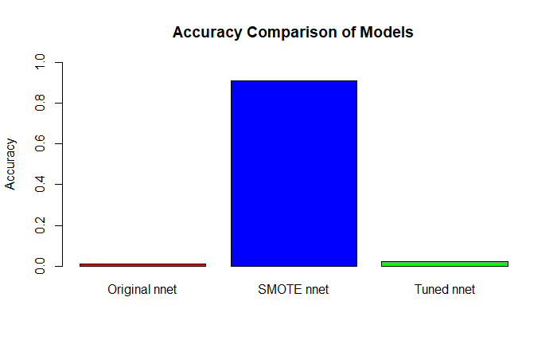
Model Accuracy and Confusion Matrix cont.
Original nnet 0.01
SMOTE nnet 0.91
Tuned nnet 0.02

Slide 10
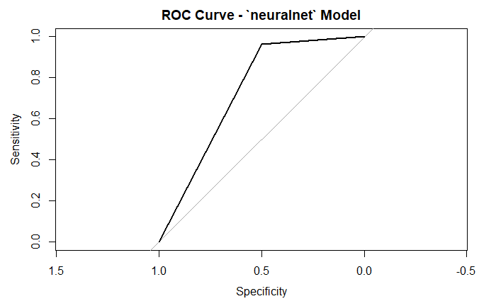
ROC Curve and Classification Criteria
ROC Curve plots True Positive Rate against False Positive Rate.
The Area Under the Curve (AUC) indicates model performance.
Adjusting the decision threshold can change the balance between sensitivity and specificity.

Slide 11
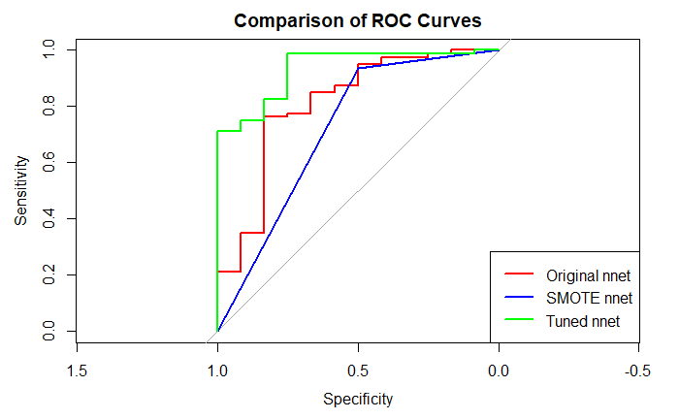
ROC Curve and Classification Criteria cont.

Slide 12
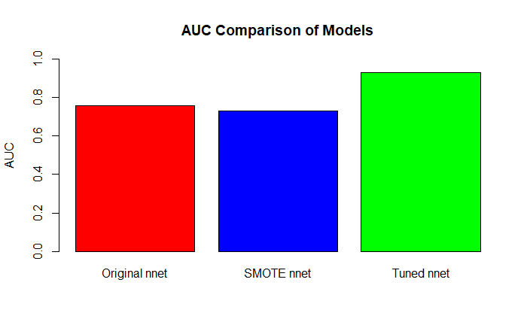
ROC Curve and Classification Criteria cont.

Slide 13
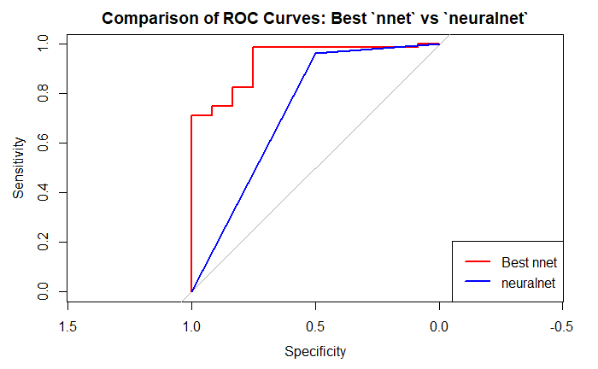
Conclusion
"Accuracy with best `nnet` model: 0.0217391304347826" "Accuracy with `neuralnet` model: 0.902173913043478"
The neuralnet model achieved an accuracy of 90.22% on the test data.
The ROC curve indicates a moderate performance, with room for improvement.
Future work could involve hyperparameter tuning and exploring different neural network architectures.

